Slide 1


Agendia
Summary of Results
Internal use only

Slide 2

Why update the Summary of Results?
Inclusion of new prospective trial data:
Level 1A MINDACT data
Late Recurrence (20yr) Low Risk result from STO-3 study
Improved usability of the Summary of Results in your discussions with patients
Provision of additional clinically meaningful information
Incorporation of feedback from consultations with physicians and patients to improve the Summary of Results
www.agendia.com

Slide 3
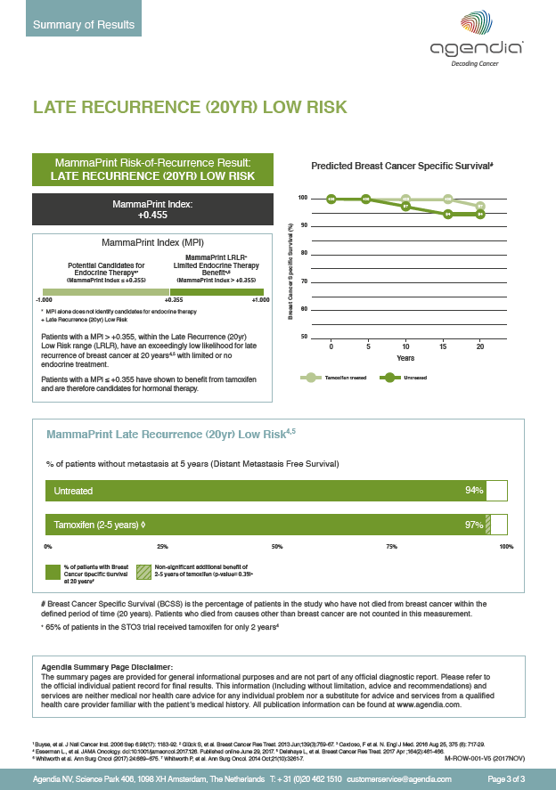
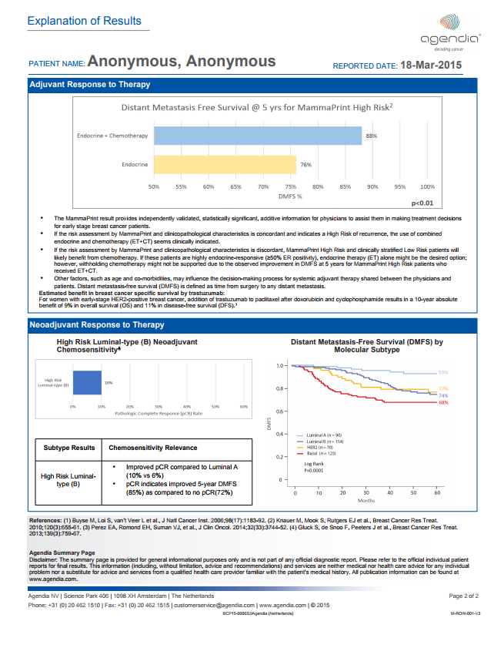
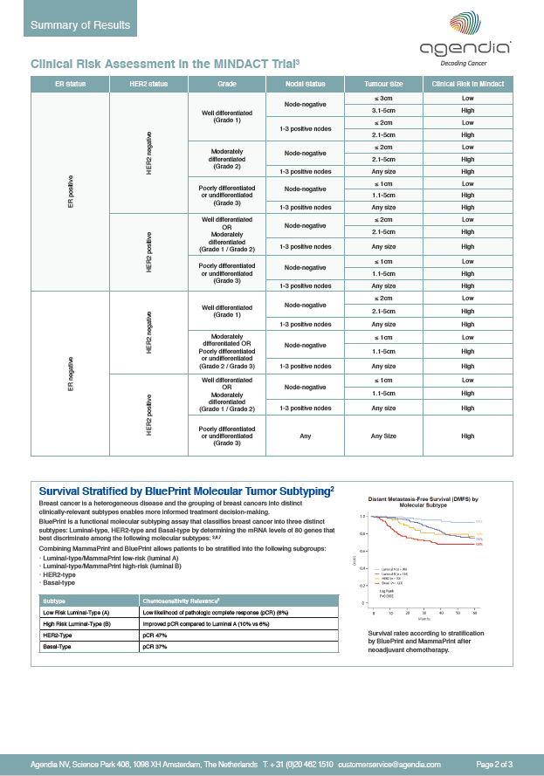
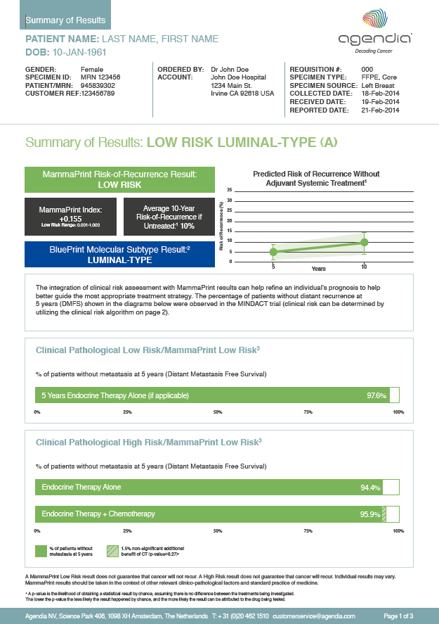
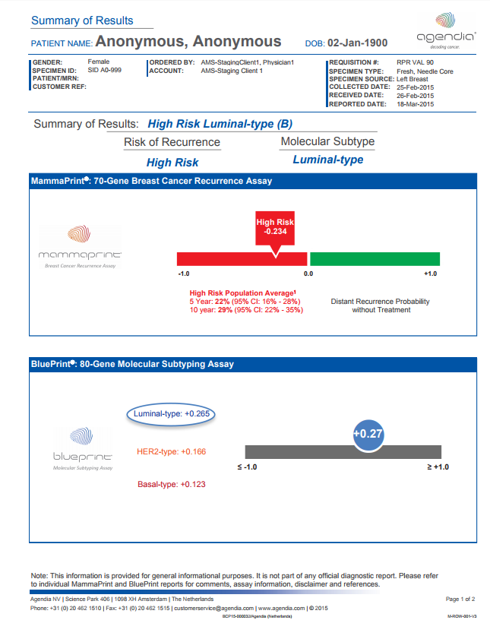
Introducing the new Summary of Results
From:
To:
www.agendia.com

Slide 4

What has changed?
Includes:
Treated data (MINDACT, Cardoso et al., 2016)
Untreated data (Buyse et al., 2006)
Late Recurrence (20yr) Low Risk (LRLR) result for applicable patients (STO-3, Esserman et al., 2017)
Clinical risk algorithm (modified Adjuvant!Online)
Demonstrates 5 and 10-year risk of recurrence more simply and succinctly
Content and format updated and localized to be more user-friendly for both physicians and patients in the EU
Refined based on feedback from customers and leading KOLs including
Prof. Fatima Cardoso
Prof. Martine Piccart
NOTE: The official MammaPrint and BluePrint Results Report will retain the same data and appearance. An update is in progress.
www.agendia.com

Slide 5

Summary of Results: Overview

Slide 6
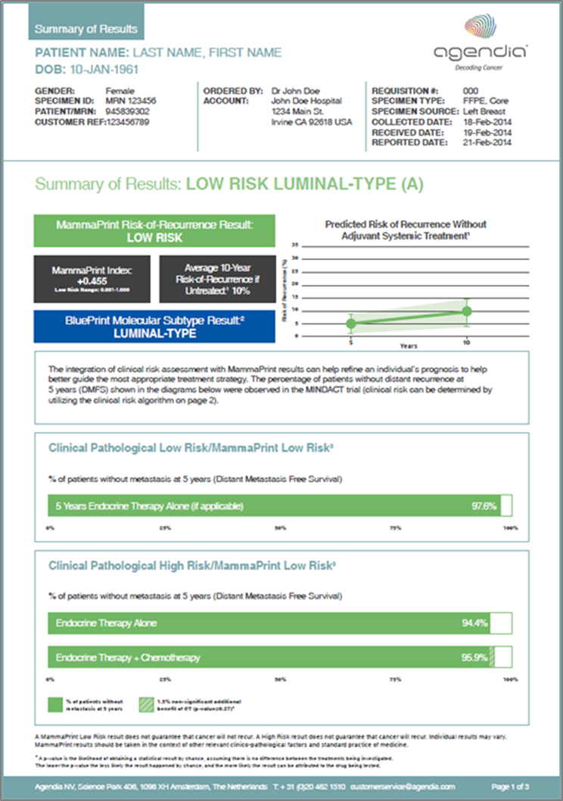
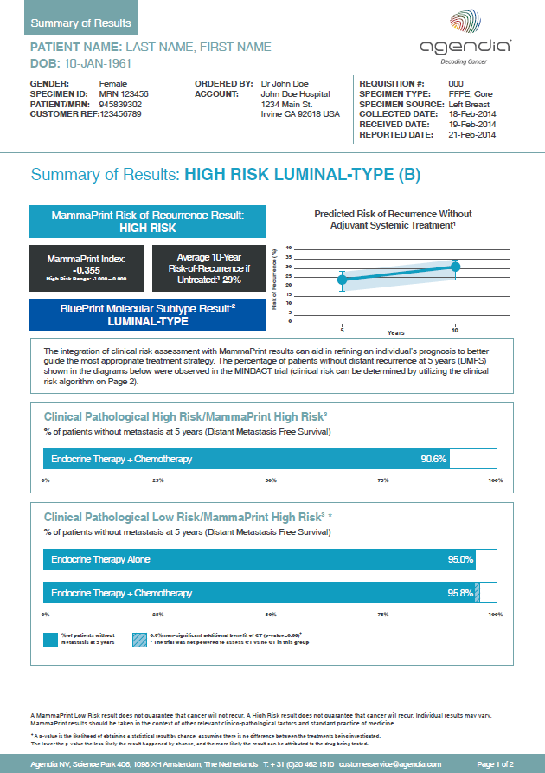
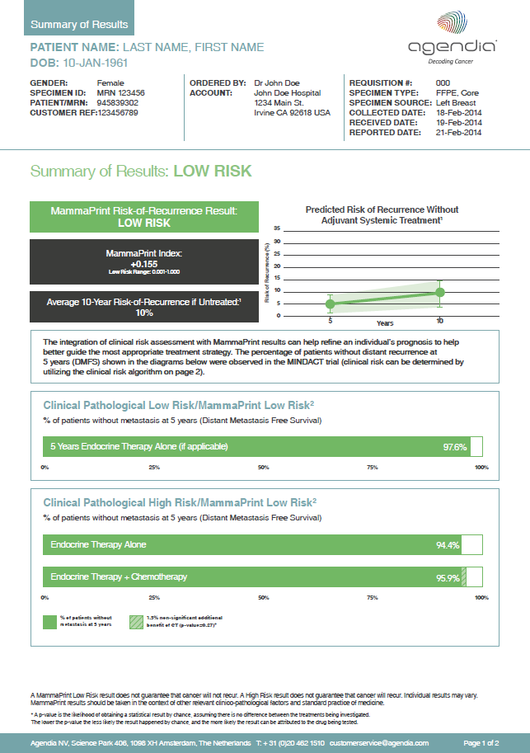
Summary of Results: Overview Page 1
Supporting data from prospective clinical trials and summary of patient-specific MammaPrint and BluePrint results
Easy-to-read MammaPrint and BluePrint (if applicable) results
MammaPrint Risk of Recurrence Result
MammaPrint Index (MPI)
BluePrint Molecular Subtype Result (when the BluePrint test has been ordered)
Prognostic validation data for MammaPrint on untreated patients
302 patients from the TRANSBIG study
Clinical utility data for MammaPrint on treated patients (treatment impact)
6,693 patients from the MINDACT trial
www.agendia.com

Slide 7
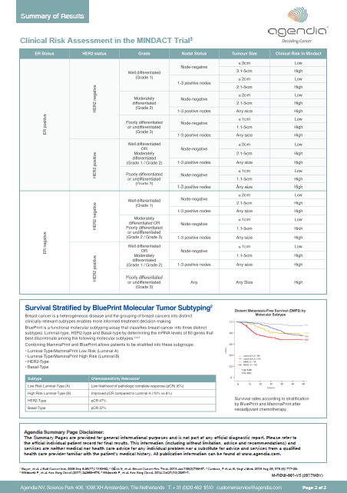
Summary of Results: Overview Page 2
Clinical risk assessment reference table and BluePrint molecular subtyping
Clinical risk algorithm (modified Adjuvant!Online)
Reproduction of algorithm used to assess clinical risk for patients in MINDACT
Information on functional molecular subtyping with BluePrint and pCR rate with neoadjuvant chemotherapy
NOTE: *Only included when BluePrint test has been ordered
Can support discussions with patients regarding their treatment management decision
*
www.agendia.com

Slide 8
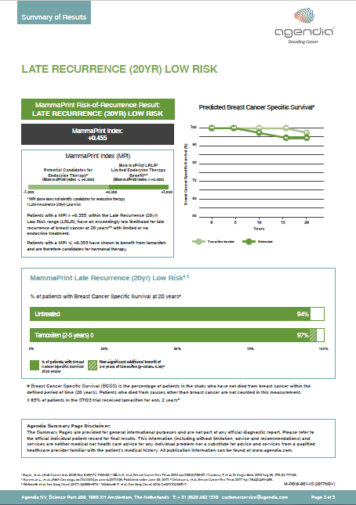
Summary of Results: Overview Page 3
MammaPrint Late Recurrence (20yr) Low Risk Result
If a patient has an MPI of > +0.355 they are Late Recurrence (20yr) Low Risk (LRLR)
This subgroup identifies patients with an excellent 20-year survival with limited or no hormone therapy
If applicable, LRLR Summary of Results will be added to the report as a third page
It contains:
Data from the STO-3 trial
20-year outcome data for patients with limited and no hormone therapy
www.agendia.com

Slide 9

Summary of Results Examples and in-depth review

Slide 10
MammaPrint Low Risk

Slide 11
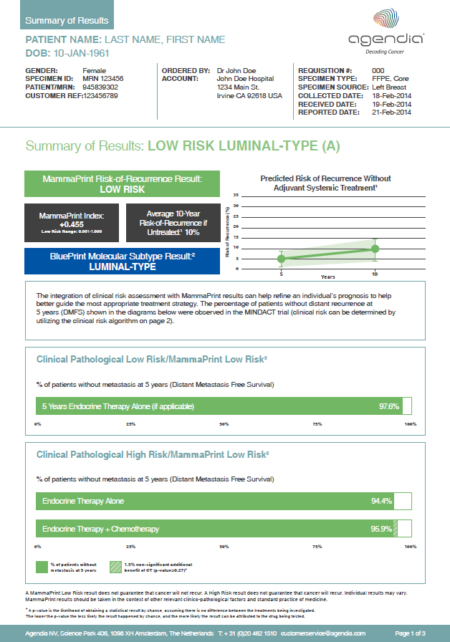
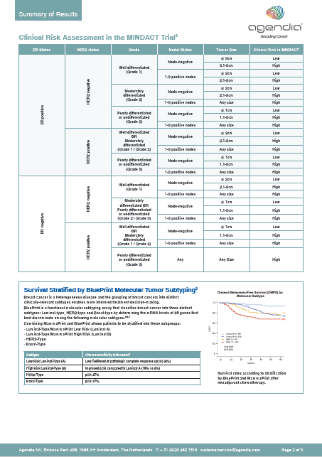
Summary of Results MammaPrint Low Risk, BluePrint Luminal-Type (A), LRLR
1
7
9
2
3
11
4
10
5
8
12
6
www.agendia.com

Slide 12
MammaPrint Low Risk Page 1

Slide 13
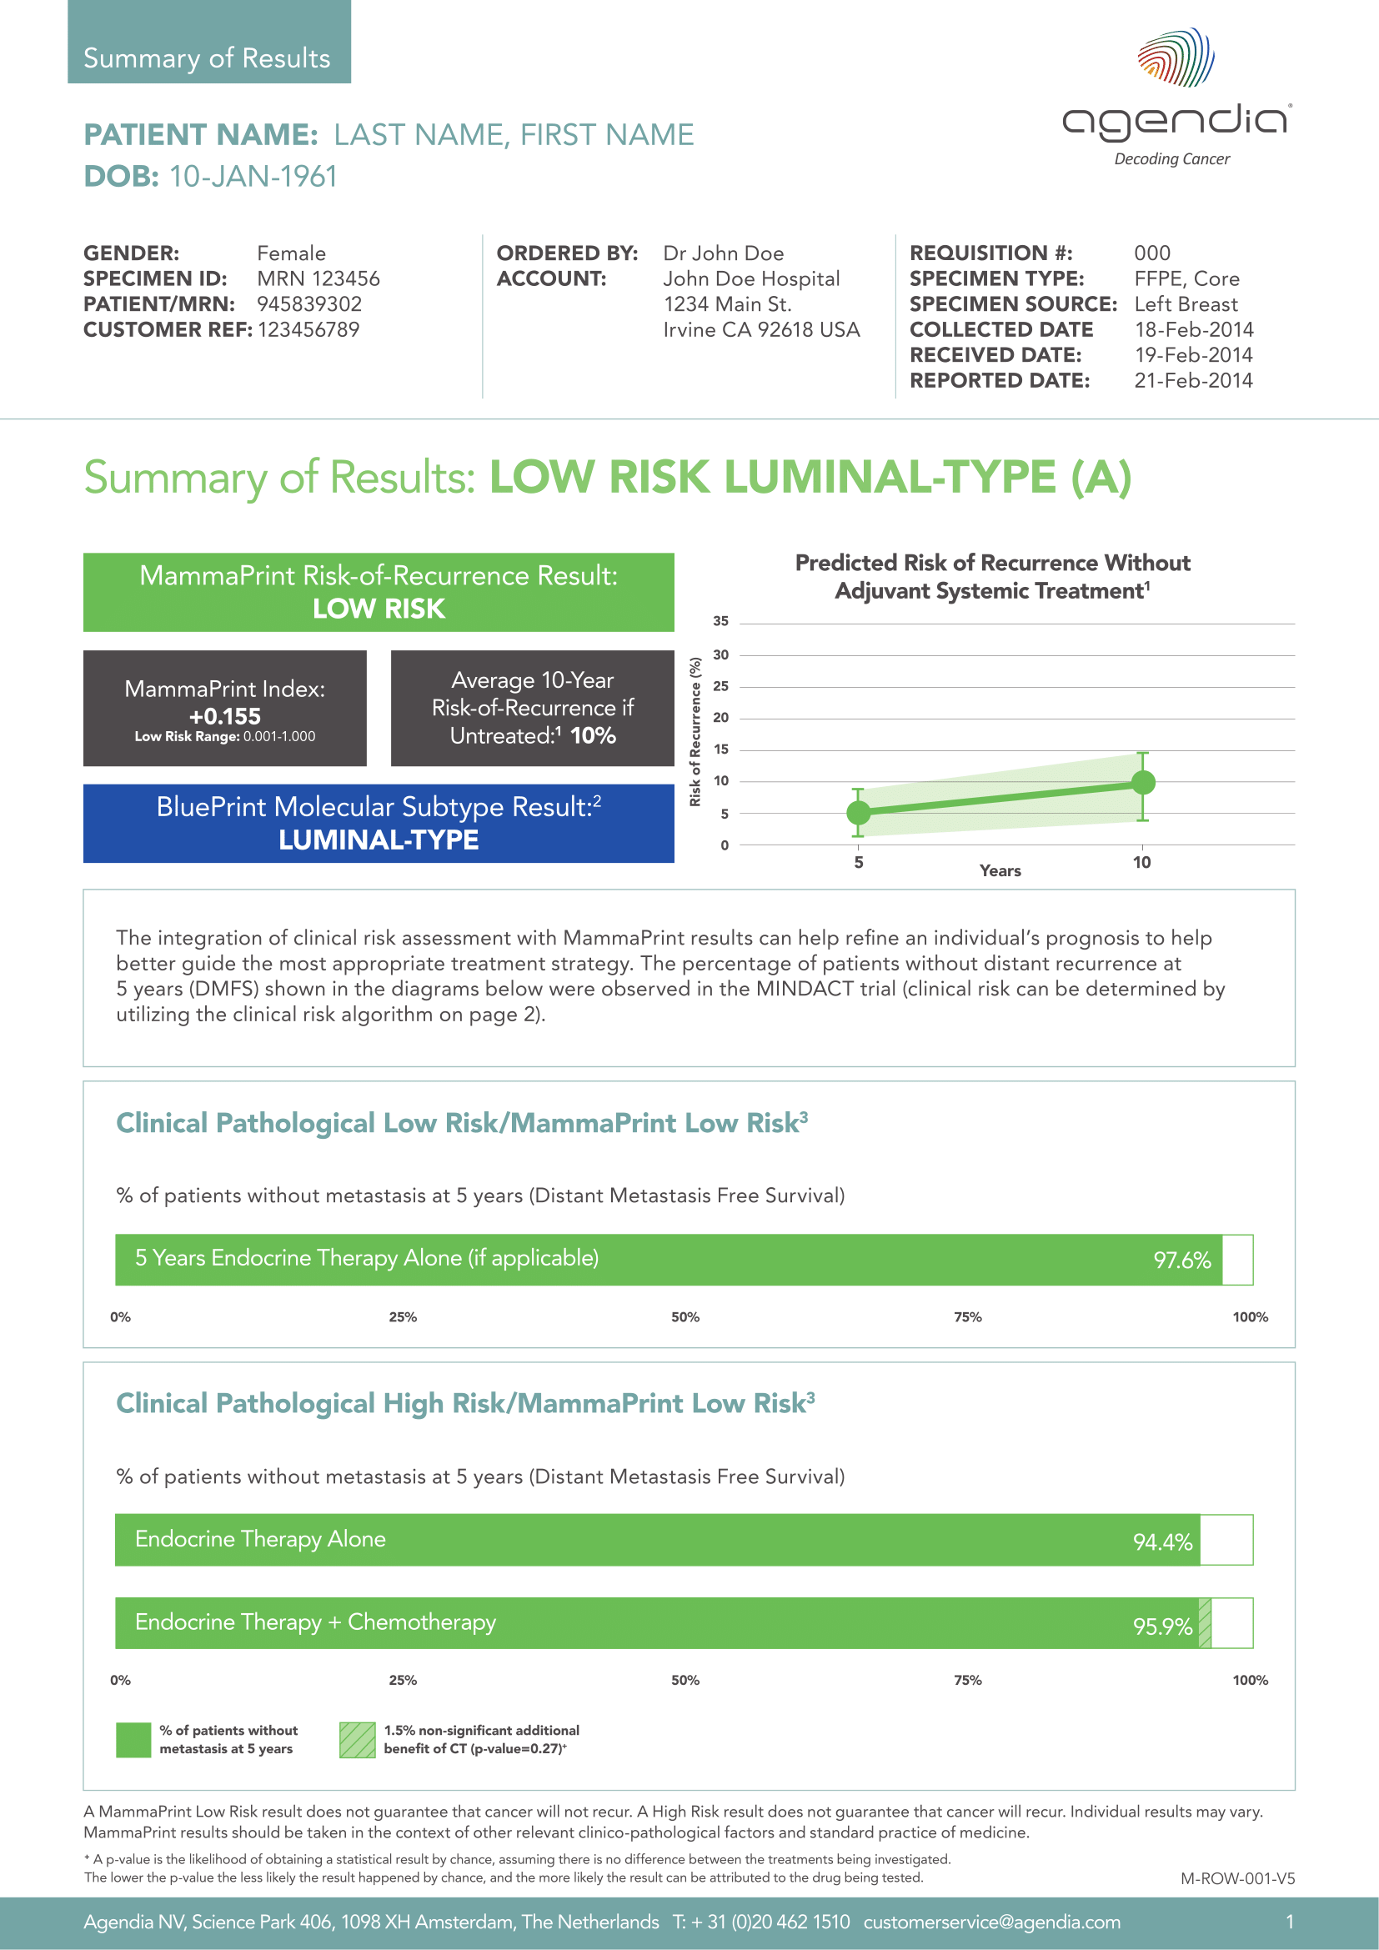
1
2
4
3
Notes:
1. Patient identification and information
Patient identifiers
Physician and hospital reference
Tumor specimen information
2. Summary of individual test result
3. Summary of results:
Binary Low Risk result
Personalized MammaPrint Index (MPI)
Average 10-year risk of recurrence 10% for untreated LN0 patients (no endocrine therapy, no chemotherapy)*
Results are based on the findings of the independent TRANSBIG study that included 302 untreated patients ¹
[1] Buyse, et al. J Natl Cancer Inst. 2006 Sep 6.98(17): 1183-92.
BluePrint result if ordered.
Risk of Recurrence at 5yr and 10yr in untreated patients
Predicted average risk of recurrence for a Low Risk patient without adjuvant treatment*
5 Year Risk: 5% (95% CI: 1% - 9%)
10 year Risk: 10% (95% CI: 4% - 15%)
Confidence intervals shaded in green on the graph
NOTE: This graph is not personalized for each specific patient

Slide 14
5
6
Notes:
5. Concordant classification
Clinical Pathological Low Risk/MammaPrint Low Risk
MINDACT data is summarized:
97.6% patients living without metastasis (DMFS)
5-year follow-up treated with endocrine therapy alone
6. Discordant classification
Clinical Pathological High Risk/MammaPrint Low Risk
5 years DMFS in MINDACT trial
94.4% DMFS endocrine therapy alone
95.9% DMFS endocrine therapy + chemotherapy
* based on the MINDACT prospective clinical trial that included 6,693 patients.³
³ Cardoso, F et al. N. Engl J Med. 2016 Aug 25, 375 (8): 717-29

Slide 15
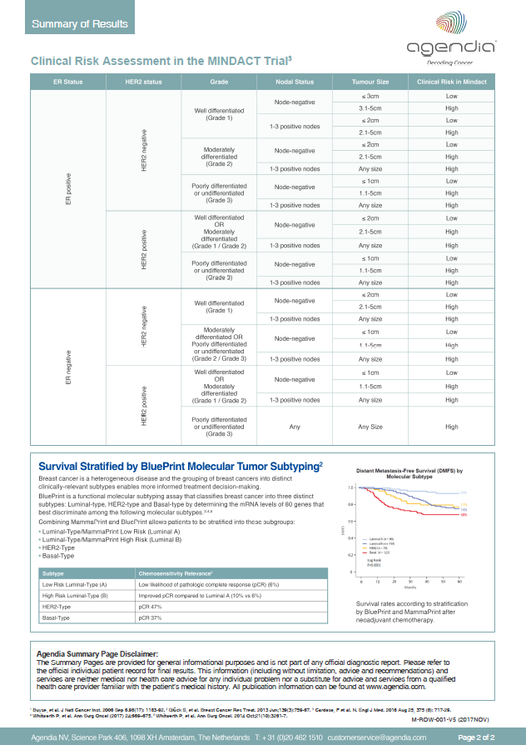
Page 2

Slide 16
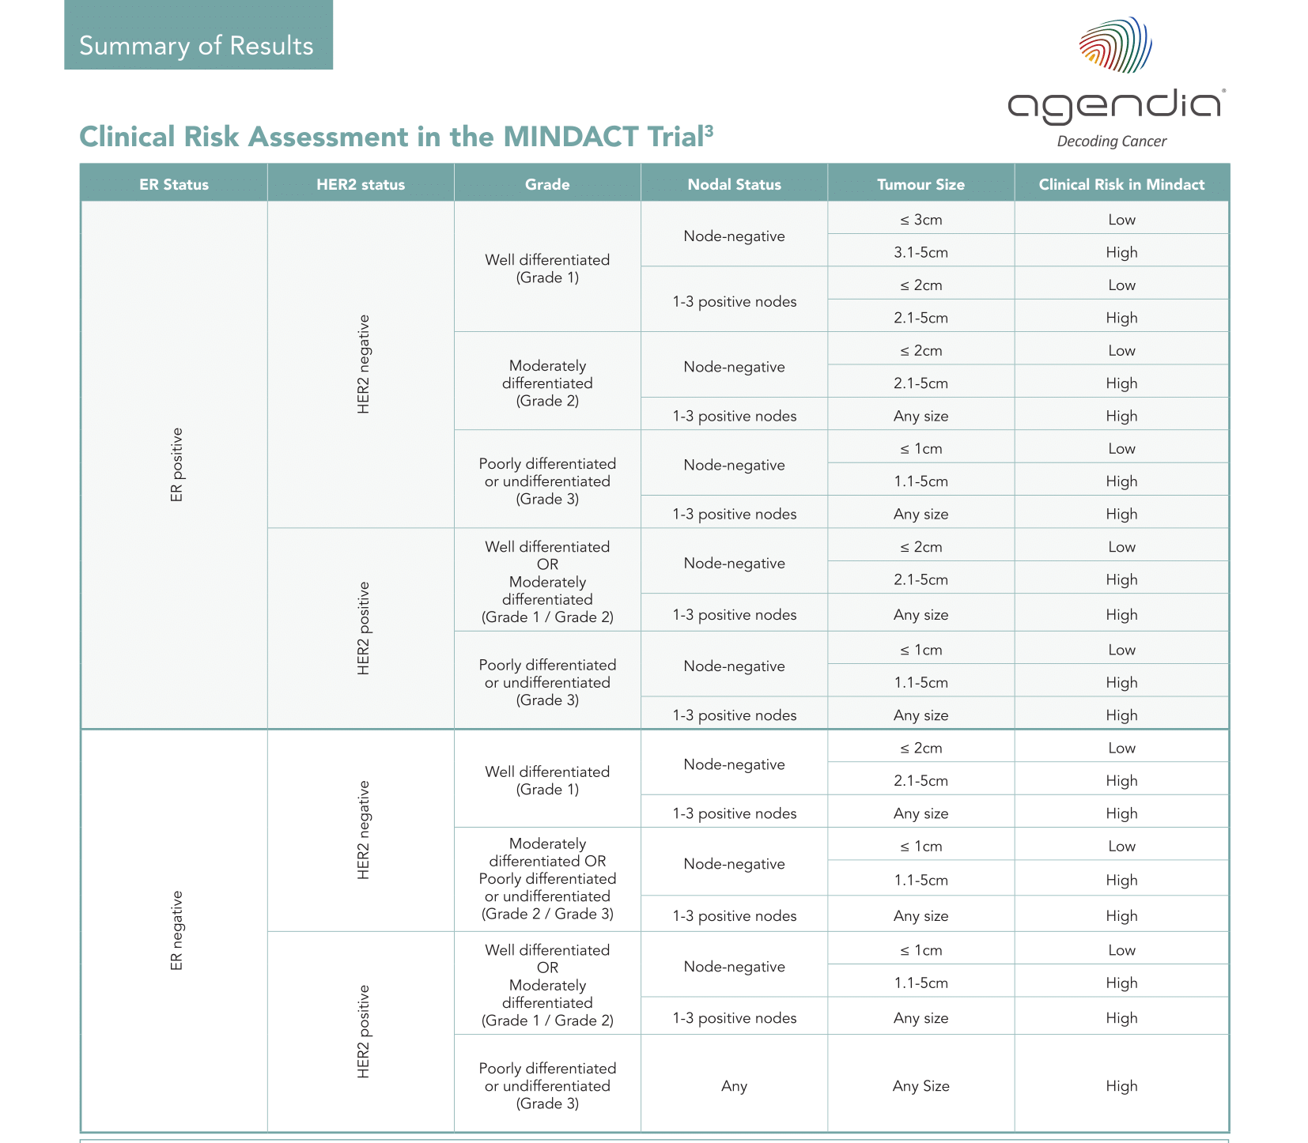
7
Notes:
7. Clinical risk assessment table
As referenced in the supplementary material of the MINDACT publication, this table can help determine the clinical risk results as observed in the MINDACT trial (i.e. clinical risk High or Low)²
Clinical risk classification in MINDACT was carried out using the modified version of Adjuvant!Online (version 8.0)²

Slide 17
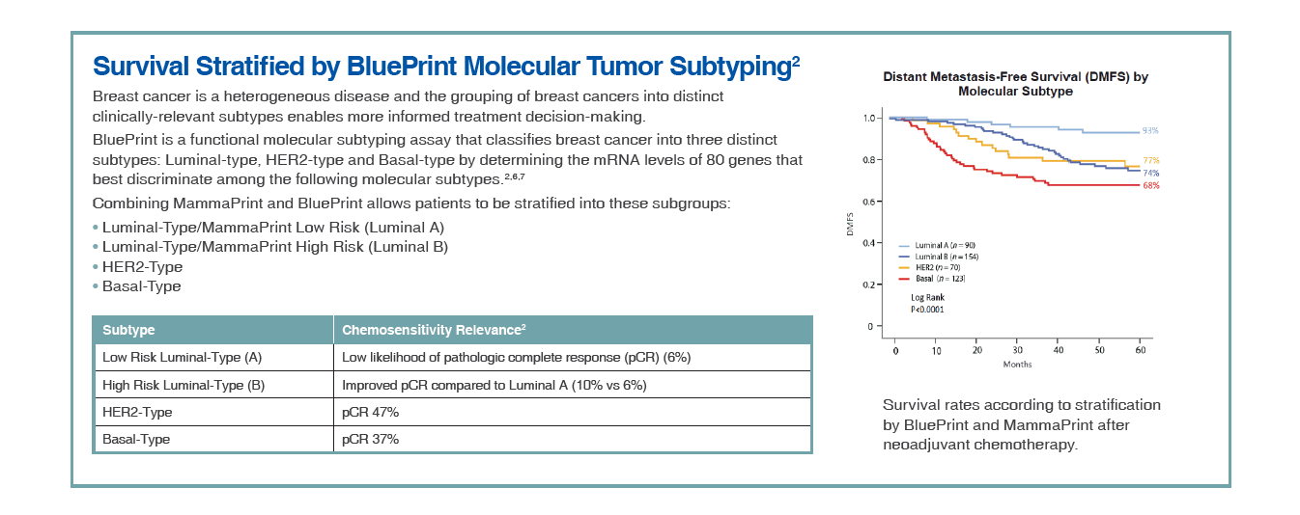
8
Notes:
8. BluePrint Molecular Subtyping Results
Neoadjuvant chemosensitivity results based on molecular subtype (expressed as rate of pCR (pathologic complete response rate) with neoadjuvant chemotherapy)
Luminal-A type would not benefit from neoadjuvant chemo – very low pCR rate
E.g. High Risk HER2 type shows 47% likelihood of pathologic complete response (pCR) with neoadjuvant chemotherapy
5-year DMFS outcomes based on molecular subtype
Results in 8 are based on a clinical study of BluePrint that included 437 patients³
[2] Glück S, et al. Breast Cancer Res Treat. 2013 Jun;139(3):759-67
[4]Whitworth P, et al. Ann Surg Oncol. (2017) 24:669–675
[5]Whitworth P, et al. Ann Surg Oncol. 2014 Oct;21(10):3261-7

Slide 18
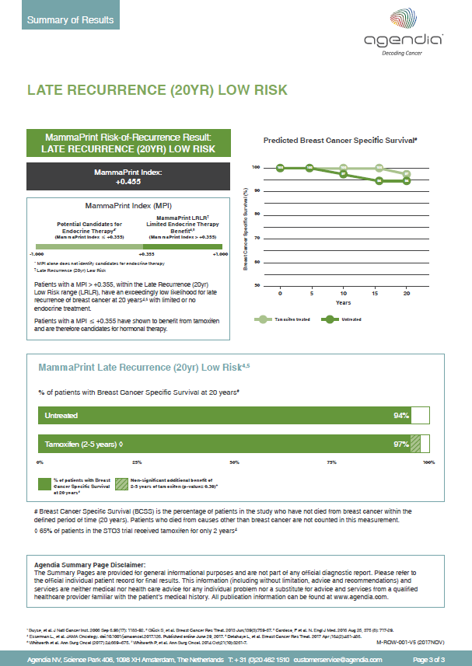
Late Recurrence (20yr) Low Risk Page 3

Slide 19
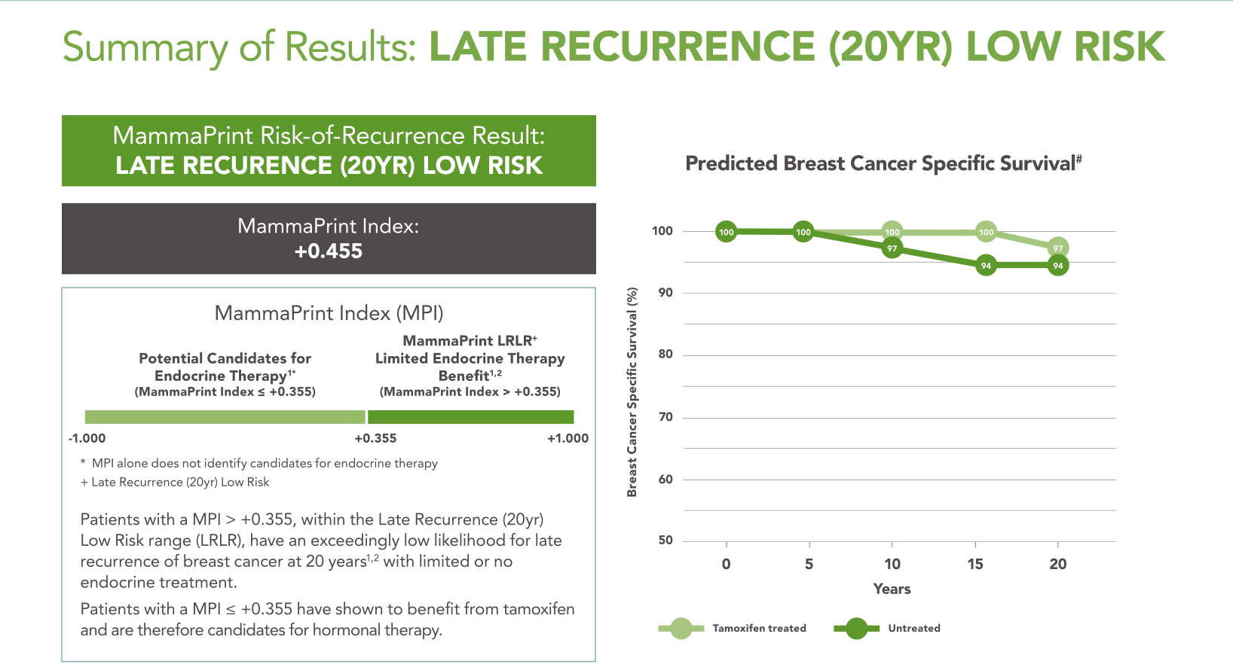
9
11
10
Notes:
9. Summary of individual test result
Personalized MammaPrint Index (MPI) in black box
10. MammaPrint Index explanation
Late Recurrence Low Risk (LRLR) - sub-group of Low Risk patients with excellent survival after 20 years with limited or no endocrine therapy⁷
Patients with a MPI > +0.355, within the Late Recurrence (20yr) Low Risk range (LRLR), have an exceedingly low likelihood for late recurrence of breast cancer at 20 years^{1,2} with limited or no endocrine treatment.
Patients with a MPI < +0.355, within the LRLR range may be candidates for endocrine therapy.
% patients living without metastasis as observed in a retrospective analysis of the STO-3 cohort
Results based on 20-year follow-up of patients untreated or treated with tamoxifen
65% of patients only received two years of adjuvant tamoxifen therapy, indicating excellent survival with limited endocrine therapy
11. Survival curve summarizing results from STO-3 trial.
In postmenopausal women with node-negative tumors 3 cm or smaller, MammaPrint reliably identifies women with minimal risk of death from breast cancer out to 20 years in the absence of any systemic therapy and negligible risk of death with 2 or more years of tamoxifen therapy alone.
⁶ STO-3 secondary analysis of the Stockholm tamoxifen (STO-3) randomized control trial of tamoxifen vs no systemic therapy, with more than 20-year follow-up, Stockholm area in Sweden, including postmenopausal women with clinically detected node-negative breast cancers treated with mastectomy or lumpectomy and radiation enrolled in the STO-3 trial, 1976 to 1990, n = 652. An indolent threshold (LRLR) was established above which no breast cancer deaths occurred after 15 years in the absence of systemic therapy.]
4 Esserman L., et al. JAMA Oncology. doi:10.1001/jamaoncol.2017.126. Published online June 29, 2017.
5 Delahaye L, et al. Breast Cancer Res Treat. 2017 Apr ;164(2):461-466.

Slide 20
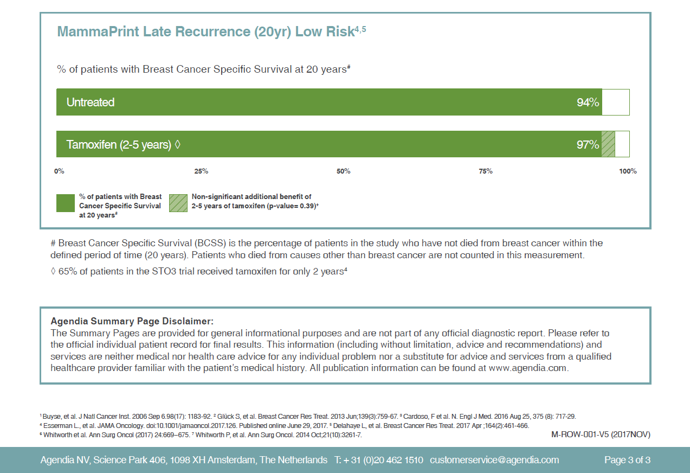
12
Notes:
MammaPrint Prognostic Result
% of patients in the clinical study who have not died from breast cancer within 20 years
94% BCSS for untreated patients
97% BCSS for 2-5yrs tamoxifen treated
no statistical difference (P-value: 0.39) between tamoxifen treated versus untreated patients at 20 years BCSS.
Most patients (65%) only received two years of adjuvant tamoxifen therapy, indicating excellent survival with limited hormone therapy treatment.
* Breast Cancer Specific Survival is the percentage of patients in the study who have not died from breast cancer within the defined period of time (20 years). Patients who died from causes other than breast cancer are not counted in this measurement.
In postmenopausal women with node-negative tumors 3 cm or smaller, MammaPrint reliably identifies women with minimal risk of death from breast cancer out to 20 years in the absence of any systemic therapy and negligible risk of death with 2 or more years of tamoxifen therapy alone.

Slide 21
MammaPrint High Risk

Slide 22
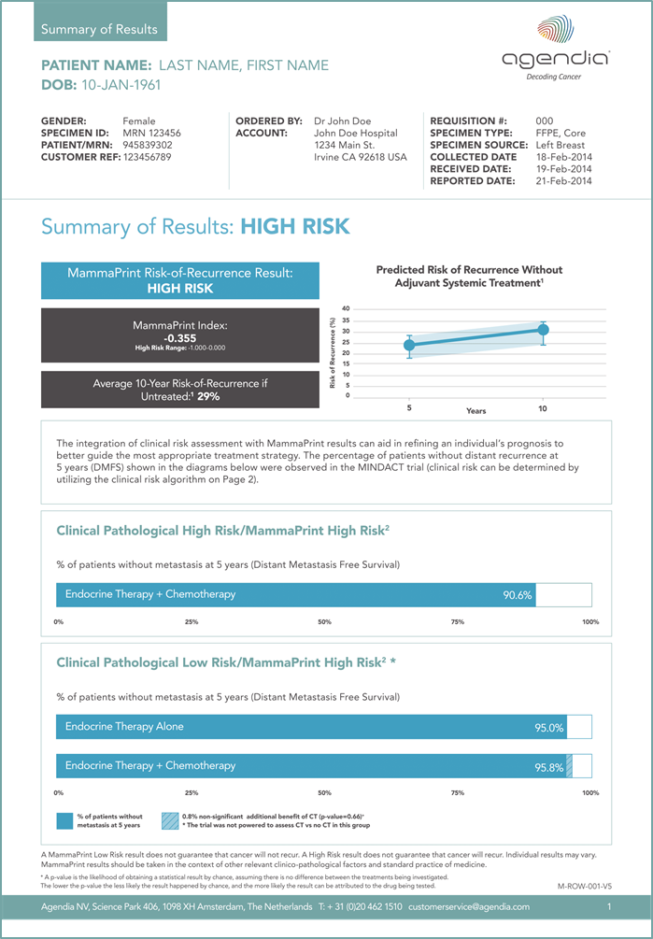
MammaPrint High Risk Page 1

Slide 23
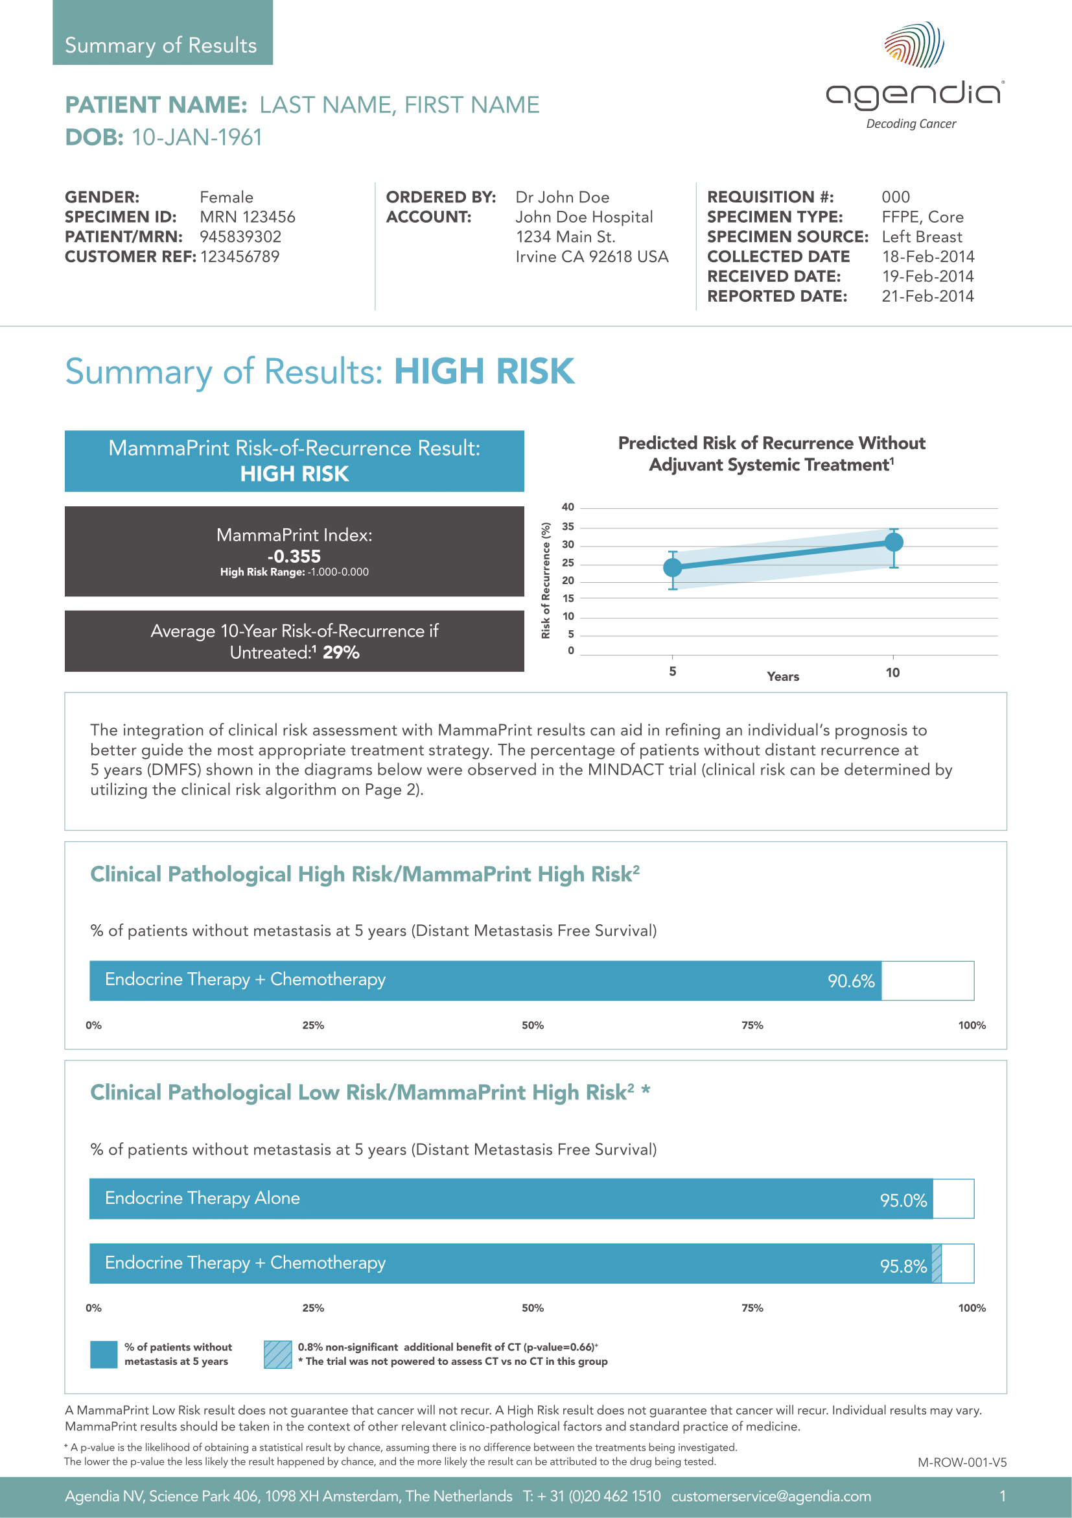
1
2
4
3
Notes:
Patient identification and information
Summary of individual test result
3 MammaPrint Prognostic Result
Binary High Risk result
Personalized MammaPrint Index (MPI)
Average 10-year risk of recurrence 29% for untreated LN0 patients (no endocrine therapy, no chemotherapy)¹
BluePrint Molecular Subtype result
4. MammaPrint Result Confidence Intervals
Predicted average risk of recurrence without adjuvant chemotherapy:
5 Year Risk: 22% (95% CI: 1% - 9%)
10 year Risk: 29% (95% CI: 4% - 15%)
Results are based on the findings of the independent TRANSBIG study that included 302 untreated patients¹

Slide 24
5
6
Notes:
5. Data from the MINDACT Trial for Concordant classification
90.6% patients living without metastasis as observed in the MINDACT trial (expressed as distant metastasis free survival (DMFS)²
Results based on 5-year follow-up of MammaPrint Low Risk patients treated with endocrine therapy and chemotherapy
These patients displayed a concordant result for clinical pathological risk and genomic risk (Clinical Pathological High Risk/MammaPrint High Risk).
6. Data from the MINDACT Trial for Discordant classification
95% patients with DMFS at 5 years in the MINDACT trial with endocrine therapy alone
95.8% patients with DMFS at 5 years in the MINDACT trial with endocrine therapy + chemotherapy
These patients displayed a discordant result for clinical pathological risk and genomic risk (Clinical Pathological Low Risk/MammaPrint High Risk)
Additional information on Clinical-Low/MP-high risk patients
If you receive the question from physicians on how to interpret the Clinical-Low/MP-high risk data from MINDACT:
Indeed MINDACT was not powered to answer chemotherapy benefit question so if you are, as a physician, sure your patient is low risk there is no need for ordering MammaPrint test.
We have additional data from MINDACT analysis presented by Tryfonidis at ESMO 2017 that hints to a subpopulation actually having benefit from CT.
More research is needed to address this question and is ongoing.
Clinical low risk T1abN0 subpopulation having benefit from CT (presented at ESMO 2017, Tryfonidis 2017)
Key take-home message:
Biological characteristics can be used as determinants of adjuvant systemic therapy administration for T1abN0 tumors. A significant portion (23.7%) of these small tumors were CL but GH (MammaPrint) risk and derived a benefit from CT.
Summary of Tryfonidis 2017 study
A subgroup analysis of the MINDACT trial indicated that high-risk disease as defined by gene expression can be found even among very early stage breast tumors (pT1a, pT1b, pN0) (Tryfonidis et al., 2017)]. A substudy of MINDACT 2017 ( included patients with pT1abN0 tumors enrolled in MINDACT who had both their genomic risk G (per MammaPrint®) & clinical risk C (per a modified version Adjuvant! Online) assessed. 826 patients with pT1abN0 tumors were enrolled in MINDACT (12.3% of all). 5-years DMFI & OS for these patients treated with CT were 98.8% (95% CI, 91.9-99.8) & 98.5% (95% CI, 89.6- 99.8) vs 91.4% (95% CI, 82.6- 95.9) & 95.8% (89.1- 98.4%) respectively for those who did not receive CT.
If adjuvant chemotherapy is administered in such clinically low but genomically high-risk cancer, the 5-year DMFS is improved from 91.4% (95% CI 82.6–95.9) to 97.3% (95% CI 89.4–99.3), again indicating that biology is more relevant than size.
Citation: K. Tryfonidis, C. Poncet, L. Slaets, G. Viale, F. de Snoo, K. Aalders, L. Van 't Veer, E. Rutgers, M. Piccart, J. Bogaerts, F. Cardoso; 150O_PR
Not all small node negative (pT1abN0) breast cancers are similar: Outcome results from an EORTC 10041/BIG 3-04 (MINDACT) trial substudy, Annals of Oncology, Volume 28, Issue suppl_5, 1 September 2017, mdx440.003, https://doi.org/10.1093/annonc/mdx440.003
Press release for background information, and abstract can be accessed for free here:
https://www.esmo.org/Press-Office/Press-Releases/Study-in-Early-Stage-Breast-Cancer-Shows-That-Even-Small-Tumours-Can-Be-Aggressive

Slide 25
Summary of Results
Resources and Support

Slide 26
Resources and Support
Please remember to download the new Summary of Results in addition to your official MammaPrint and BluePrint Results Report.
For more information please visit:
www.agendia.com/healthcare-professionals/row-summary-of-results
Further questions?
Please contact your local Agendia representative or our Customer Service team by calling +31 20 462 1510, or by email at customerservice@agendia.com

Slide 27
Thank you for your attention

Slide 28
For more information about Agendia and our products visit www.agendia.com or contact:
T: +31 (0)20 462 1510
E: customerservice@agendia.com
Follow us on Twitter | LinkedIn | Facebook
www.agendia.com
M-ROW-199-V1 (2018JUL)

